Slide 1
Analysis Of Factors Influencing A Candidate In Getting Placed

Slide 2
Overview and problem statement
Students are trying their best to get placed in this competitive job market.
Students need to make smart choices to increase their chances of being placed.
What are the factors influencing a candidate in getting placed?
Notes:
We are framing this problem in terms of a clear business need. And asking the question, what is this analysis actually going to do for our business, right? Remember, it’s our world, the statistics are just living in it!

Slide 3
Data analyzed
1720 records total; 15 variables
1184 records for Placed; 536records for Not placed
Data includes: Secondary/ Higher Secondary Education percentage, Board of Education, Specialization in Higher Secondary Education, Degree, Degree type, Work Experience, Employability test percentage, Post Grad Specialization, MBA percentage
Raw data available here
Notes:
Set the stage a bit -- where is the data coming from? Be as transparent as possible. Explain to the audience what you were thinking about data collection in terms of what data was necessary and how that in turn shaped your thinking on the kind of analysis that would be most appropriate given the objective.

Slide 4

Model Preparation
Target – Status, which is a categorial variable and it is converted to dummy variable
Features – 6 numerical variables + 7 categorial variables which are converted to 9 dummy variables
Training/Testing split: testing size = 0.2
Use GridSearchCV to find the best params
Notes:
Moving from research question to some kind of hypothesis -- you want to use logic, theory and prior empirical evidence to move toward some hypotheses you can test. This is why domain expertise cannot be overlooked among data scientists.

Slide 5
Model Selection
Models analyzed:
PCA
Logistic Regression
KNN
Decision Tree,
Random Forest
Gradient Boosting
Selection criteria:
1. Less overfit – Smaller difference between training score and testing score
2. Model Efficiency - Higher cross validation score
3. Confusion matrix – Higher accuracy, recall, and precision score
Winner-------Logistic Regression Model

Slide 6
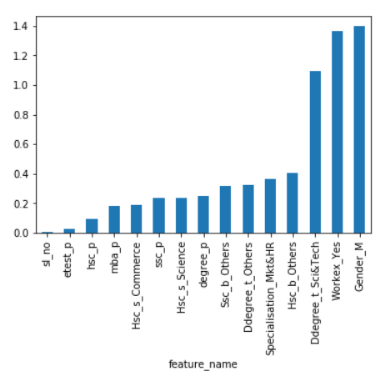
Feature importance
For the winning model – Logistic Regression – I used coefficient values to measure the feature importance
Notes:
Moving from research question to some kind of hypothesis -- you want to use logic, theory and prior empirical evidence to move toward some hypotheses you can test. This is why domain expertise cannot be overlooked among data scientists.

Slide 7
Top 5 important features influencing a candidate in getting placed are:
Gender_M - Male compared to female is more likely to be placed
Workex_Yes – those who have work experience are more likely to be placed
Ddegree_t_Sci&Tech - Sci&Tech is less likely to be placed
Board of Education- students in central board are less likely to be placed
Specialization - Mkt&HR are less likely to be placed

Slide 8
Weak points
1. Data is not very detailed
For example there are only 3 unique values in degree type and 2 unique values in specialization, which might explain the surprising finding -Sci&Tech is less likely to be placed compared to other degrees(Mgt and Other)
2. Total data is not large enough -- only 215 entries
3. Imbalanced data -- 148 placed vs 67 not placed

Slide 9
Making smart choices
You can not choose your gender, but you can choose to……
1. Have more work experience by finding interns or being a TA
2. Select majors and specialization wisely
3. Move out of the central board
Notes:
https://unsplash.com/photos/OX_en7CXMj4
Then we want to move to recommendations, what is the call to action? What should your audience do now that they know what you have told them?

Slide 10
Questions?

Slide 11
Thank You

